Slide 1
What to expect, look forward to and how to help give your child the best start

Slide 2
Meet the team
Miss Smythe
Year 3 LSA
Mr Donnellan
Year 3 Class Teacher

Slide 3
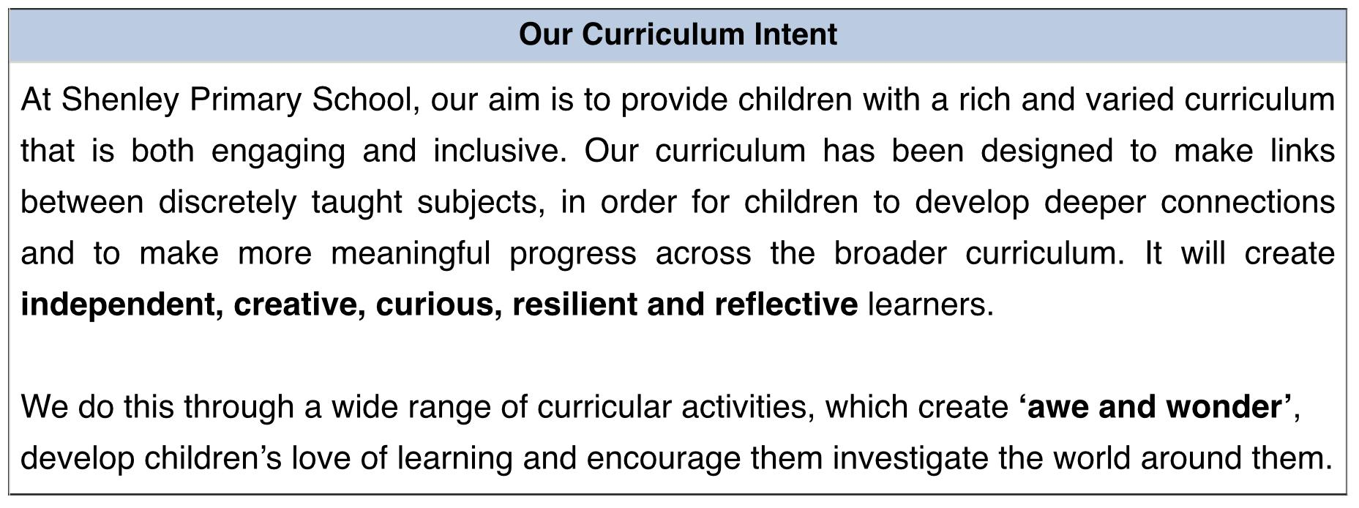
The Curriculum

Slide 4
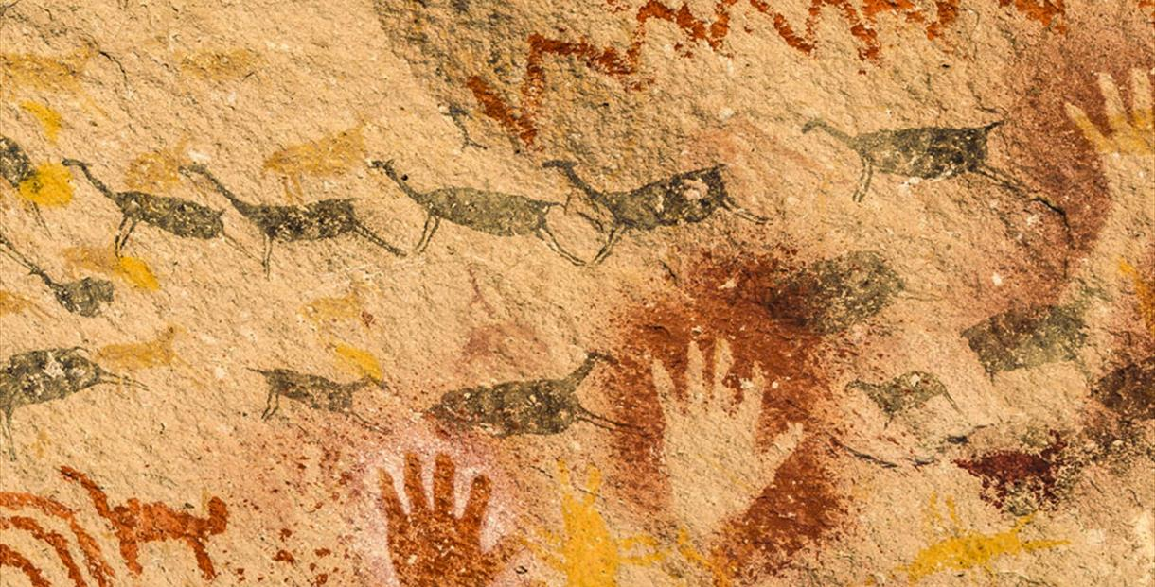
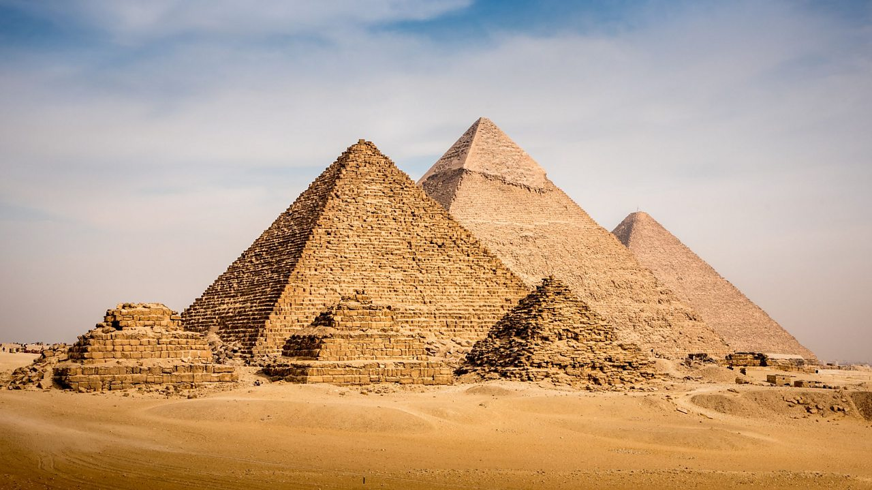
Autumn Term
Dig Deep and Discover
Spring Term
All Creatures Great and Small
Summer Term
Ancient Egypt

Slide 5
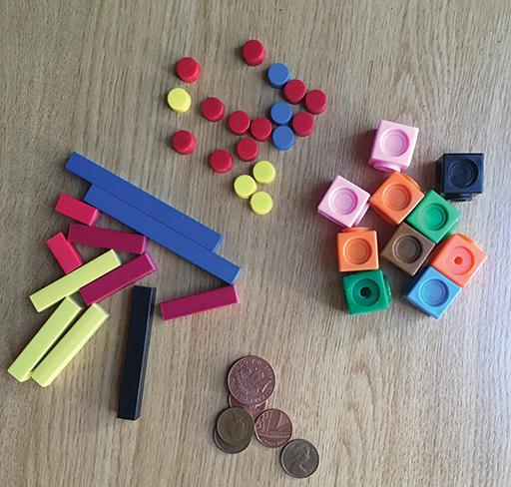
Mathematics
Learn the facts for the 3 ,4 and 8 times tables
Become more familiar with telling the time
Grow more confident using column addition and subtraction
Build and recognise fractions
Recognise 2D and 3D shapes
Improve mental arithmetic

Slide 6
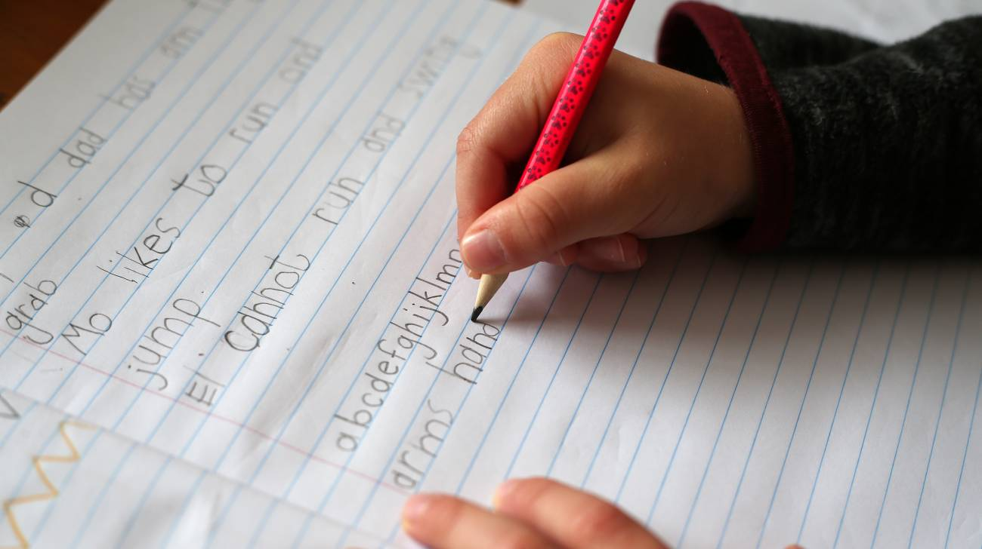
English
Write across a range of genres
Use a variety of conjunctions, prepositions and adverbs
Plan and proofread writing
Use inverted commas to punctuate speech
Spell correctly words with prefixes and suffixes along with homophones and commonly misspelt words
Develop handwriting

Slide 7
Reading
Read a variety of texts
Use the Reading Vipers to explore vocabulary, infer, predict, explain and retrieve information
Follow along as others read
Express opinions about texts
Improve fluency and expression

Slide 8
Homework
Set weekly
Spellings, a writing task and a maths task to be completed
Daily reading logged
Times Tables Rockstars

Slide 9
Things to look forward to
P.E, Swimming and Forest School
Learning Assemblies
WOW Days
Field trip
Residential

Slide 10
Thank you for coming
We are all really excited for a brilliant Year!

